Slide 1
Ancient Egyptian portraits
.

Slide 2
Craftsmen were appreciated rather than respected in ancient Egypt.
Craftsmen were not allowed to sign their work. That's because several craftsmen might work on one object. But even when only one artist worked on something, they still could not sign it.
A craftsman with skill usually enjoyed a very comfortable lifestyle. Although their work was not signed, word did get around.

Slide 3
The Egyptians had a unique way of drawing people.
They drew heads, eyes, legs and feet positioned as if you were looking at them from the side.
They drew the shoulders and the chest as if you were looking at them from the front.
Men were usually drawn with dark colors.
Women were usually drawn with light colors

Slide 4
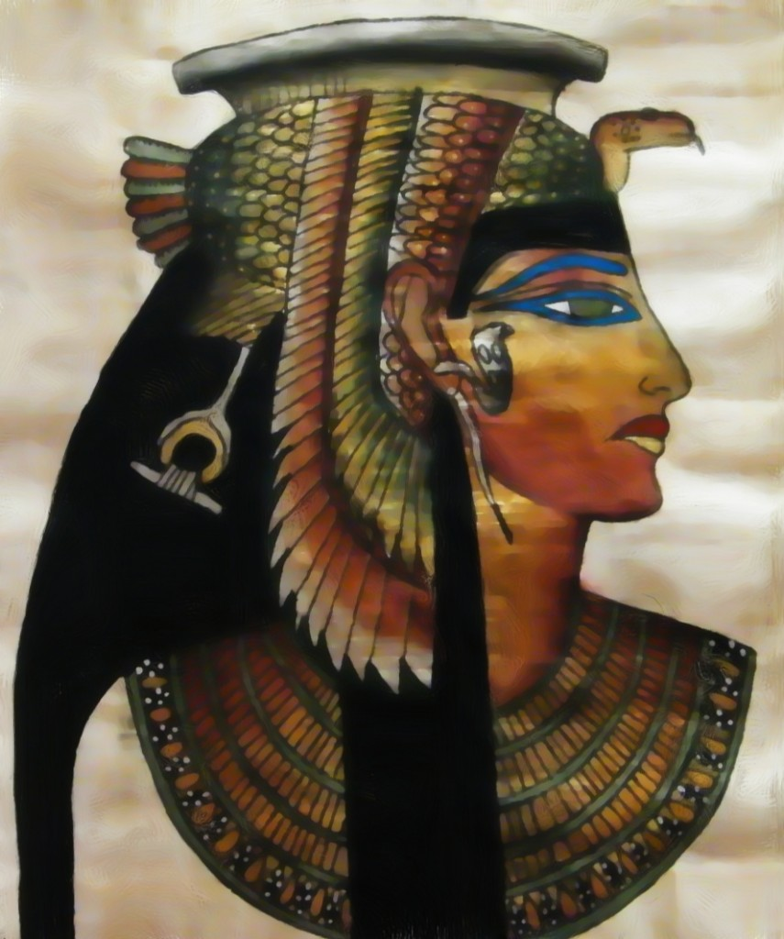
,

Slide 5
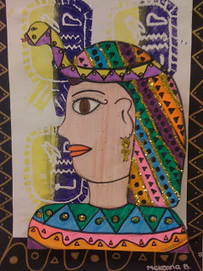
.

Slide 6
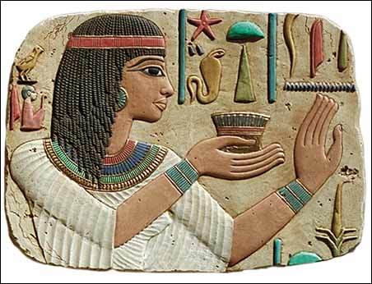
.

Slide 7
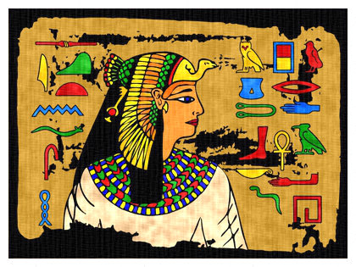
.
This portrait is based upon a painting of Queen Nefertari from her tomb in the Valley of the Queens. Queen Nefertari is usually shown wearing the Royal Vulture Crown of the goddess Nekhbet, the protector of Upper Egypt. Nefertari was the favourite wife of the greatest of all the pharaohs, Rameses II, and she bore him at least six children.

Slide 8
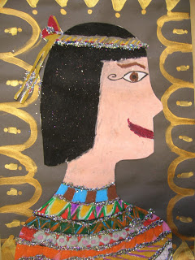
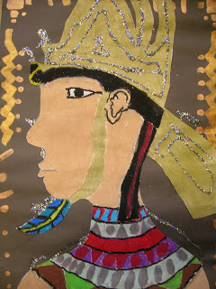
.

Slide 9
The Main colours used..
Blue
Gold
Orange
Black
Purple

Slide 10
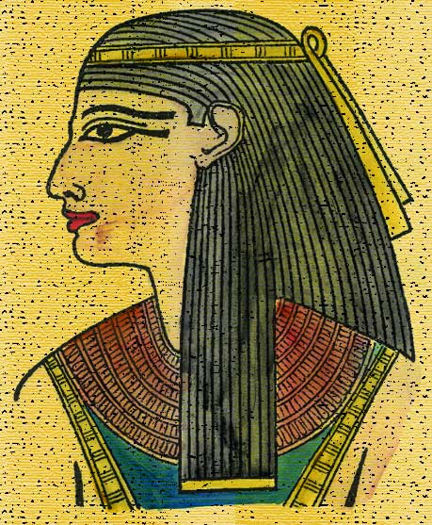
.

Slide 11
Now its your turn!!!
☺

